Slide 1

Classification and Prediction
What is classification? What is prediction?
Issues regarding classification and prediction
Classification by decision tree induction
Rule-based classification
Instance-based methods
Moso J : Dedan Kimathi University
Notes:
Moso J : Dedan Kimathi University

Slide 2
Classification: Definition
Given a collection of records (training set )
  Each record contains a set of attributes, one of the attributes is the class.
Find a model for class attribute as a function of the values of other attributes.
Goal: previously unseen records should be assigned a class as accurately as possible.
  A test set is used to determine the accuracy of the model. Usually, the given data set is divided into training and test sets, with training set used to build the model and test set used to validate it.
Moso J : Dedan Kimathi University

Slide 3

Illustrating Classification Task
Moso J : Dedan Kimathi University

Slide 4




Examples of Classification Task
Predicting tumor cells as benign or malignant
Classifying credit card transactions
as legitimate or fraudulent
Classifying secondary structures of protein
as alpha-helix, beta-sheet, or random
coil
Categorizing news stories as finance,
weather, entertainment, sports, etc
Moso J : Dedan Kimathi University

Slide 5
Supervised vs. Unsupervised Learning
Supervised learning (classification)
  Supervision: The training data (observations, measurements, etc.) are accompanied by labels indicating the class of the observations
  New data is classified based on the training set
Unsupervised learning (clustering)
  The class labels of training data is unknown
  Given a set of measurements, observations, etc. with the aim of establishing the existence of classes or clusters in the data
Moso J : Dedan Kimathi University

Slide 6
What Is Prediction?
(Numerical) prediction is similar to classification
  construct a model
  use model to predict continuous or ordered value for a given input
Prediction is different from classification
  Classification refers to predict categorical class label
  Prediction models continuous-valued functions
Major method for prediction: regression
  model the relationship between one or more independent or predictor variables and a dependent or response variable
Regression analysis
  Linear and multiple regression
  Non-linear regression
  Other regression methods: generalized linear model, Poisson regression, log-linear models, regression trees
Moso J : Dedan Kimathi University

Slide 7
Classification vs. Prediction
Classification
  Predicts categorical class labels
  Classifies data (constructs a model) based on the training set and the values (class labels) in a classifying attribute and uses it in classifying new data
Prediction
  Models continuous-valued functions, i.e., predicts unknown or missing values
Typical applications
  Credit approval
  Target marketing
  Medical diagnosis
  Fraud detection
Moso J : Dedan Kimathi University
Notes:
Moso J : Dedan Kimathi University

Slide 8
Classification—A Two-Step Process
Model construction: describing a set of predetermined classes
  Each tuple/sample is assumed to belong to a predefined class, as determined by the class label attribute
  The set of tuples used for model construction is training set
  The model is represented as classification rules, decision trees, or mathematical formulae
Model usage: for classifying future or unknown objects
  Estimate accuracy of the model
    The known label of test sample is compared with the classified result from the model
    Accuracy rate is the percentage of test set samples that are correctly classified by the model
    Test set is independent of training set, otherwise over-fitting will occur
  If the accuracy is acceptable, use the model to classify data tuples whose class labels are not known
Moso J : Dedan Kimathi University

Slide 9



Process (1): Model Construction
Classification
Algorithms
Training
Data
Classifier
(Model)
IF rank = ‘professor’
OR years > 6
THEN tenured = ‘yes’
Moso J : Dedan Kimathi University

Slide 10




Process (2): Using the Model in Prediction
Classifier
Testing
Data
Unseen Data
(Jeff, Professor, 4)
Tenured?
Moso J : Dedan Kimathi University
Notes:
Moso J : Dedan Kimathi University

Slide 11
Issues: Data Preparation
Data cleaning
  Preprocess data in order to reduce noise and handle missing values
Relevance analysis (feature selection)
  Remove the irrelevant or redundant attributes
Data transformation
  Generalize and/or normalize data
Moso J : Dedan Kimathi University

Slide 12
Issues: Evaluating Classification Methods
Accuracy
  classifier accuracy: predicting class label
  predictor accuracy: guessing value of predicted attributes
Speed
  time to construct the model (training time)
  time to use the model (classification/prediction time)
Robustness: handling noise and missing values
Scalability: efficiency in disk-resident databases
Interpretability
  understanding and insight provided by the model
Other measures, e.g., goodness of rules, such as decision tree size or compactness of classification rules
Moso J : Dedan Kimathi University

Slide 13
Decision Tree learning
Decision tree learning – a method for approximating discrete-valued target functions. The learned function is represented by a decision tree or as if-then rules which are easier for humans to read
Applications
  Classification of medical patients by their disease,
  Equipment malfunctions by their cause
  Loan applicants by their likelihood of defaulting on payments
Moso J : Dedan Kimathi University

Slide 14
Classification by Decision Tree Induction
Decision Tree
An internal node is a test on an attribute.
A branch represents an outcome of the test, e.g., Color=red.
A leaf node represents a class label or class label distribution.
At each node, one attribute is chosen to split training examples into distinct classes as much as possible
A new instance is classified by following a matching path to a leaf node.
Moso J : Dedan Kimathi University

Slide 15
Classification by Decision Tree Induction
Decision tree generation consists of two phases
  Top-down Tree construction
    At start, all the training examples are at the root
    Partition examples recursively based on selected attributes
  Bottom-up Tree pruning
    Identify and remove branches that reflect noise or outliers, to improve the estimated accuracy on new cases
Use of decision tree: Classifying an unknown sample
  Test the attribute values of the sample against the decision tree
Moso J : Dedan Kimathi University

Slide 16
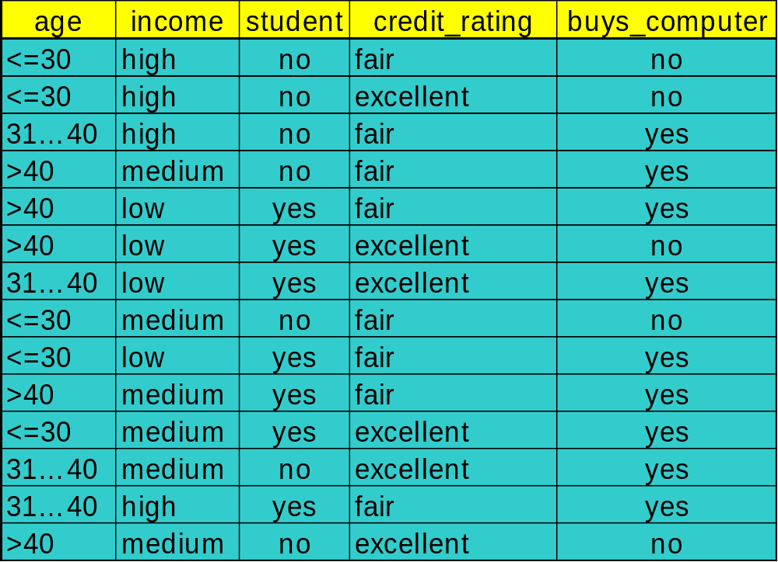
Training Dataset
This follows an example of Quinlan’s ID3 (Playing Tennis)
Moso J : Dedan Kimathi University

Slide 17
Output: A Decision Tree for “buys_computer”
age?
<=30
overcast
>40
31..40
student?
yes
credit rating?
no
yes
excellent
fair
no
yes
no
yes
Moso J : Dedan Kimathi University

Slide 18
When Should Decision Trees Be Used?
When instances are <attribute, value> pairs
  Values are typically discrete, but can be continuous
The target function has discrete output values – Boolean, more than two outputs or even real-valued
Disjunctive descriptions might be needed
  A tree naturally represents a disjunction of rules
Training data might contain errors
  Robust to errors of classification and attribute values
Some of the training examples might contain missing values. Several methods for completion of unknown values
Moso J : Dedan Kimathi University

Slide 19
Algorithm for Decision Tree Induction
Basic algorithm (a greedy algorithm)
  Tree is constructed in a top-down recursive divide-and-conquer manner
  At start, all the training examples are at the root
  Attributes are categorical (if continuous-valued, they are discretized in advance)
  Examples are partitioned recursively based on selected attributes
  Test attributes are selected on the basis of a heuristic or statistical measure (e.g., information gain)
Conditions for stopping partitioning
  All samples for a given node belong to the same class
  There are no remaining attributes for further partitioning – majority voting is employed for classifying the leaf
  There are no samples left
Moso J : Dedan Kimathi University

Slide 20
Choosing the Splitting Attribute
At each node, available attributes are evaluated on the basis of separating the classes of the training examples. A Goodness function is used for this purpose.
Typical goodness functions:
  Information gain (ID3/C4.5)
  Gain ratio
  Gini index
Moso J : Dedan Kimathi University

Slide 21
A criterion for attribute selection
Which is the best attribute?
  The one which will result in the smallest tree
  Heuristic: choose the attribute that produces the “purest” nodes
Popular impurity criterion: information gain
  Information gain increases with the average purity of the subsets that an attribute produces
Strategy: choose attribute that results in greatest information gain
Moso J : Dedan Kimathi University

Slide 22
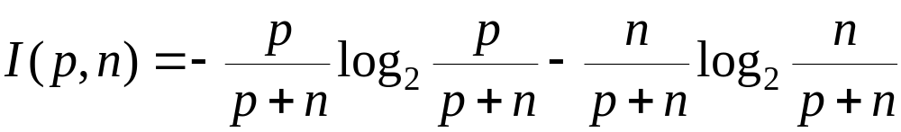
Information Gain (ID3/C4.5)
Select the attribute with the highest information gain
Assume there are two classes, P and N
  Let the set of examples S contain p elements of class P and n elements of class N
  The amount of information, needed to decide if an arbitrary example in S belongs to P or N is defined as
Moso J : Dedan Kimathi University

Slide 23
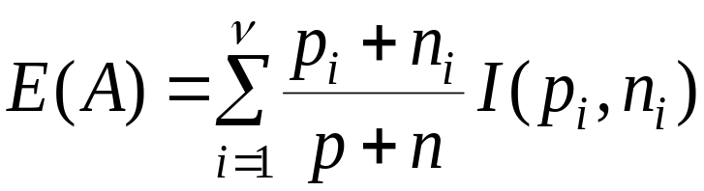
Information Gain in Decision Tree Induction
Assume that using attribute A a set S will be partitioned into sets {S₁, S₂ , …, S_{v}}
  If S_{i} contains p_{i} examples of P and n_{i} examples of N, the entropy, or the expected information needed to classify objects in all subtrees S_{i} is
The encoding information that would be gained by branching on A
Moso J : Dedan Kimathi University

Slide 24
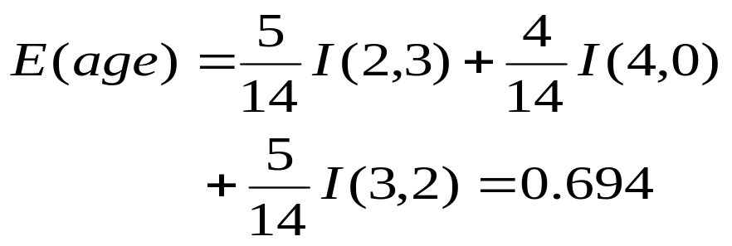
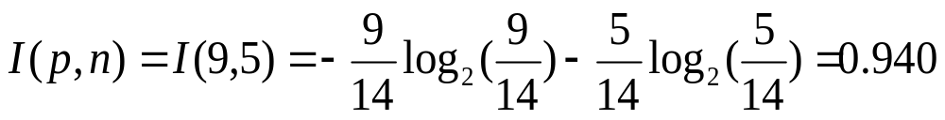



Attribute Selection: Information Gain
Class P: buys_computer = “yes”
Class N: buys_computer = “no”
Compute the entropy for age:
Note:
Hence
= 0.940- 0.694= 0.246
Similarly
Moso J : Dedan Kimathi University

Slide 25
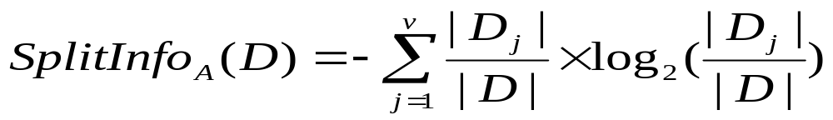
Gain Ratio for Attribute Selection (C4.5)
Information gain measure is biased towards attributes with a large number of values
C4.5 (a successor of ID3) uses gain ratio to overcome the problem (normalization to information gain)
  GainRatio(A) = Gain(A)/SplitInfo(A)
Ex.
  gain_ratio(income) = 0.029/0.926 = 0.031
The attribute with the maximum gain ratio is selected as the splitting attribute
Moso J : Dedan Kimathi University

Slide 26

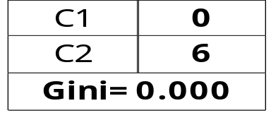
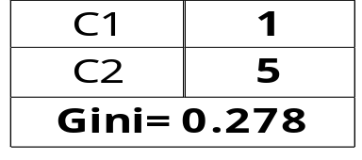
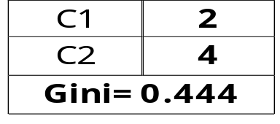
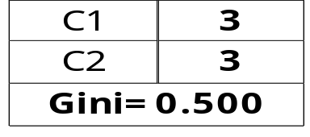
Measure of Impurity: Gini index
Gini Index for a given node t :
    (NOTE: p( j | t) is the relative frequency of class j at node t).
  Maximum (1 - 1/n_{c}) when records are equally distributed among all classes, implying least interesting information
  Minimum (0.0) when all records belong to one class, implying most interesting information
Moso J : Dedan Kimathi University

Slide 27
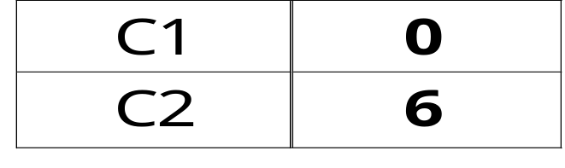
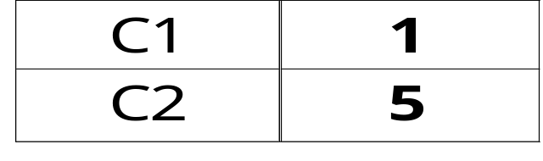
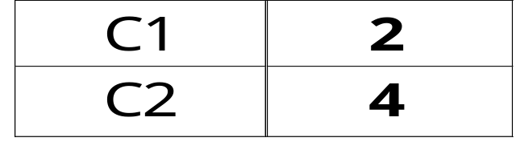
Examples for computing GINI
P(C1) = 0/6 = 0 P(C2) = 6/6 = 1
Gini = 1 – P(C1)² – P(C2)² = 1 – 0 – 1 = 0
P(C1) = 1/6 P(C2) = 5/6
Gini = 1 – (1/6)² – (5/6)² = 0.278
P(C1) = 2/6 P(C2) = 4/6
Gini = 1 – (2/6)² – (4/6)² = 0.444
Moso J : Dedan Kimathi University

Slide 28

Splitting Based on GINI
Used in CART, SLIQ, SPRINT.
When a node p is split into k partitions (children), the quality of split is computed as,
where, n_{i} = number of records at child i,
n = number of records at node p.
Moso J : Dedan Kimathi University

Slide 29
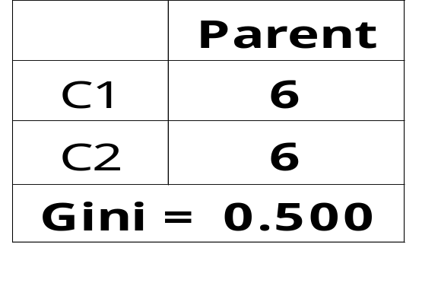
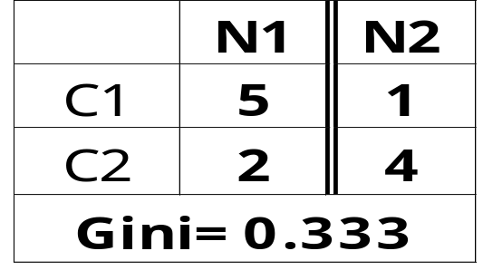
Binary Attributes: Computing GINI Index
Splits into two partitions
Effect of Weighing partitions:
  Larger and Purer Partitions are sought for.
B?
Yes
No
Node N1
Node N2
Gini(N1)
= 1 – (5/6)² – (2/6)²
= 0.194
Gini(N2)
= 1 – (1/6)² – (4/6)²
= 0.528
Gini(Children)
= 7/12 * 0.194 +
5/12 * 0.528
= 0.333
Moso J : Dedan Kimathi University

Slide 30
Avoid Overfitting in Classification
The generated tree may overfit the training data
  Too many branches, some may reflect anomalies due to noise or outliers
  Result is in poor accuracy for unseen samples
Two approaches to avoid overfitting
  Prepruning: Halt tree construction early—do not split a node if this would result in the goodness measure falling below a threshold
    Difficult to choose an appropriate threshold
  Postpruning: Remove branches from a “fully grown” tree—get a sequence of progressively pruned trees
    Use a set of data different from the training data to decide which is the “best pruned tree”
Moso J : Dedan Kimathi University

Slide 31
Enhancements to Basic Decision Tree Induction
Allow for continuous-valued attributes
  Dynamically define new discrete-valued attributes that partition the continuous attribute value into a discrete set of intervals
Handle missing attribute values
  Assign the most common value of the attribute
  Assign probability to each of the possible values
Attribute construction
  Create new attributes based on existing ones that are sparsely represented
  This reduces fragmentation, repetition, and replication
Moso J : Dedan Kimathi University

Slide 32
Advantages of decision trees
  Relatively faster learning speed (than other classification methods)
  Rules generated are easy to interpret and understand
  Can use SQL queries for accessing databases
  Comparable classification accuracy with other methods
  Easy to use and efficient
  Trees can be constructed for data with many attributes.
Moso J : Dedan Kimathi University

Slide 33
Disadvantages of decision trees
  May suffer from overfitting.
  Does not easily handle nonnumeric data.
  Can be quite large – pruning is necessary.
  Curse of dimension
Moso J : Dedan Kimathi University

Slide 34
Using IF-THEN Rules for Classification
Represent the knowledge in the form of IF-THEN rules
  R: IF age = youth AND student = yes THEN buys_computer = yes
  Rule antecedent/precondition vs. rule consequent
Assessment of a rule: coverage and accuracy
  n_{covers} = number of tuples covered by R
  n_{correct} = number of tuples correctly classified by R
  coverage(R) = n_{covers} /|D| /* D: training data set */
  accuracy(R) = n_{correct} / n_{covers}
If more than one rule is triggered, need conflict resolution
  Size ordering: assign the highest priority to the triggering rules that has the “toughest” requirement (i.e., with the most attribute test)
  Class-based ordering: decreasing order of prevalence or misclassification cost per class
  Rule-based ordering (decision list): rules are organized into one long priority list, according to some measure of rule quality or by experts
Moso J : Dedan Kimathi University

Slide 35
Rule Extraction from a Decision Tree
Rules are easier to understand than large trees
One rule is created for each path from the root to a leaf
Each attribute-value pair along a path forms a conjunction: the leaf holds the class prediction
Rules are mutually exclusive and exhaustive
age?
<=30
31..40
>40
student?
yes
credit rating?
no
yes
excellent
fair
no
yes
no
yes
Example: Rule extraction from our buys_computer decision-tree
  IF age = young AND student = no THEN buys_computer = no
  IF age = young AND student = yes THEN buys_computer = yes
  IF age = mid-age THEN buys_computer = yes
  IF age = old AND credit_rating = excellent THEN buys_computer = yes
  IF age = young AND credit_rating = fair THEN buys_computer = no
Data Mining: Concepts and Techniques

Slide 36
Instance-Based Methods
Instance-based learning:
  Store training examples and delay the processing (“lazy evaluation”) until a new instance must be classified
Typical approaches
  k-nearest neighbor approach
    Instances represented as points in a Euclidean space.
  Locally weighted regression
    Constructs local approximation
  Case-based reasoning
    Uses symbolic representations and knowledge-based inference
Moso J : Dedan Kimathi University

Slide 37
The k-Nearest Neighbor Algorithm
All instances correspond to points in the n-D space.
The nearest neighbor are defined in terms of Euclidean distance.
The target function could be discrete- or real- valued.
For discrete-valued, the k-NN returns the most common value among the k training examples nearest to xq.
Voronoi diagram: the decision surface induced by 1-NN for a typical set of training examples.
.
_
_
.
+
_
.
+
.
.
_
xq
+
_
.
+
Moso J : Dedan Kimathi University

Slide 38
Discussion on the k-NN Algorithm
The k-NN algorithm for continuous-valued target functions
  Calculate the mean values of the k nearest neighbors
Distance-weighted nearest neighbor algorithm
  Weight the contribution of each of the k neighbors according to their distance to the query point x_{q}
    giving greater weight to closer neighbors
  Similarly, for real-valued target functions
Robust to noisy data by averaging k-nearest neighbors
Curse of dimensionality: distance between neighbors could be dominated by irrelevant attributes.
  To overcome it, axes stretch or elimination of the least relevant attributes.
Moso J : Dedan Kimathi University

Slide 39
Case-Based Reasoning
Also uses: lazy evaluation + analyze similar instances
Difference: Instances are not “points in a Euclidean space”
Example: Water faucet problem in CADET (Sycara et al’92)
Methodology
  Instances represented by rich symbolic descriptions (e.g., function graphs)
  Multiple retrieved cases may be combined
  Tight coupling between case retrieval, knowledge-based reasoning, and problem solving
Research issues
  Indexing based on syntactic similarity measure, and when failure, backtracking, and adapting to additional cases
Moso J : Dedan Kimathi University

Slide 40
Remarks on Lazy vs. Eager Learning
Instance-based learning: lazy evaluation
Decision-tree : eager evaluation
Key differences
  Lazy method may consider query instance xq when deciding how to generalize beyond the training data D
  Eager method cannot since they have already chosen global approximation when seeing the query
Efficiency: Lazy - less time training but more time predicting
Accuracy
  Lazy method effectively uses a richer hypothesis space since it uses many local linear functions to form its implicit global approximation to the target function
  Eager: must commit to a single hypothesis that covers the entire instance space
Moso J : Dedan Kimathi University

Slide 41
Other Classification Methods
Bayesian Classification
Classification by back propagation
Genetic algorithm
Rough set approach
Fuzzy set approaches
Moso J : Dedan Kimathi University

Slide 42
Bayesian Classification: Why?
A statistical classifier: performs probabilistic prediction, i.e., predicts class membership probabilities
Foundation: Based on Bayes’ Theorem.
Performance: A simple Bayesian classifier, naïve Bayesian classifier, has comparable performance with decision tree and selected neural network classifiers
Incremental: Each training example can incrementally increase/decrease the probability that a hypothesis is correct — prior knowledge can be combined with observed data
Standard: Even when Bayesian methods are computationally intractable, they can provide a standard of optimal decision making against which other methods can be measured
Moso J : Dedan Kimathi University

Slide 43
Bayesian Theorem: Basics
Let X be a data sample (“evidence”): class label is unknown
Let H be a hypothesis that X belongs to class C
Classification is to determine P(H|X), the probability that the hypothesis holds given the observed data sample X
P(H) (prior probability), the initial probability
  E.g., X will buy computer, regardless of age, income, …
P(X): probability that sample data is observed
P(X|H) (posteriori probability), the probability of observing the sample X, given that the hypothesis holds
  E.g., Given that X will buy computer, the prob. that X is 31..40, medium income
Moso J : Dedan Kimathi University

Slide 44
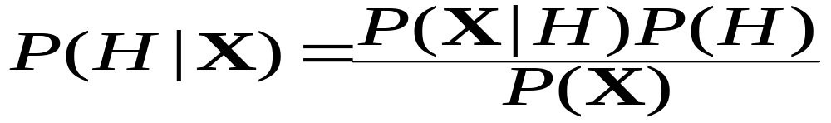
Bayesian Theorem
Given training data X, posteriori probability of a hypothesis H, P(H|X), follows the Bayes theorem
Informally, this can be written as
  posteriori = likelihood x prior/evidence
Predicts X belongs to C₂ iff the probability P(C_{i}|X) is the highest among all the P(C_{k}|X) for all the k classes
Practical difficulty: require initial knowledge of many probabilities, significant computational cost
Moso J : Dedan Kimathi University

Slide 45
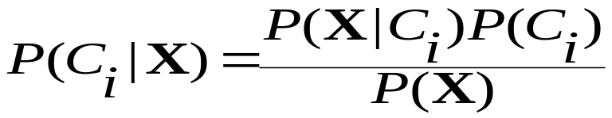

Towards Naïve Bayesian Classifier
Let D be a training set of tuples and their associated class labels, and each tuple is represented by an n-D attribute vector X = (x₁, x₂, …, x_{n})
Suppose there are m classes C₁, C₂, …, C_{m}.
Classification is to derive the maximum posteriori, i.e., the maximal P(C_{i}|X)
This can be derived from Bayes’ theorem
Since P(X) is constant for all classes,
only needs to be maximized
Moso J : Dedan Kimathi University

Slide 46

Naïve Bayesian Classifier: Training Dataset
Class:
C1:buys_computer = ‘yes’
C2:buys_computer = ‘no’
Data sample
X = (age <=30,
Income = medium,
Student = yes
Credit_rating = Fair)
Moso J : Dedan Kimathi University

Slide 47
Naïve Bayesian Classifier: An Example
P(C_{i}): P(buys_computer = “yes”) = 9/14 = 0.643
P(buys_computer = “no”) = 5/14= 0.357
Compute P(X|C_{i}) for each class
P(age = “<=30” | buys_computer = “yes”) = 2/9 = 0.222
P(age = “<= 30” | buys_computer = “no”) = 3/5 = 0.6
P(income = “medium” | buys_computer = “yes”) = 4/9 = 0.444
P(income = “medium” | buys_computer = “no”) = 2/5 = 0.4
P(student = “yes” | buys_computer = “yes) = 6/9 = 0.667
P(student = “yes” | buys_computer = “no”) = 1/5 = 0.2
P(credit_rating = “fair” | buys_computer = “yes”) = 6/9 = 0.667
P(credit_rating = “fair” | buys_computer = “no”) = 2/5 = 0.4
X = (age <= 30 , income = medium, student = yes, credit_rating = fair)
P(X|C_{i}) : P(X|buys_computer = “yes”) = 0.222 x 0.444 x 0.667 x 0.667 = 0.044
P(X|buys_computer = “no”) = 0.6 x 0.4 x 0.2 x 0.4 = 0.019
  P(X|C_{i})*P(C_{i}) : P(X|buys_computer = “yes”) * P(buys_computer = “yes”) = 0.028
  P(X|buys_computer = “no”) * P(buys_computer = “no”) = 0.007
Therefore, X belongs to class (“buys_computer = yes”)
Data Mining: Concepts and Techniques

